Slide 1
Automation Operation Concept For Next CNES Missions

Slide 2
Automation Operation Concept For Next CNES Missions
History of ISIS
ISIS Product Line
  Architecture
  Subsystems
  Main drivers
ISIS Operational Concept
  From Assembly to Deployment
  During operational phase
Conclusion : First feedback

Slide 3

3 partners :
Thales Alénia Space,
Airbus Defense and Space, and CNES
ISIS : Initiative for Space Innovative Standard

Slide 4
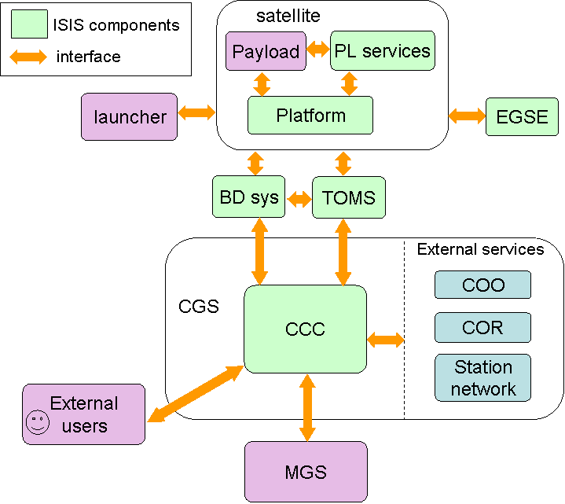
ISIS Standard
Automation Operation Concept For Next CNES Missions
ISIS Standard includes :
Standard documentation
Typical mission documents to be tailored
Covering :
  All aspects of the platform and command control ground segment
  The interfaces within ISIS components and with external entities
ISIS Product Line

Slide 5

ISIS Product Line : software architecture
Automation Operation Concept For Next CNES Missions
Standards based design
SOA architecture with components
ISIS Product Line
Follows CCSDS MO (SM&C) standard
  Service Oriented components
  Talking on a Message Abstraction Layer
  Modular approach
  Simple function addition/removal (tailoring of the CCC)
ISIS Standard implementation:
  XTCE, SLE, CCSDS TM/TC, PUS (subset), COP1
  Other specific ISIS interfaces
Daemons
C++ / Python
Processings
C++ / Python
GUIs
C++ / Python + Qt/JavaScript
Scripts
Python
~ 100 components
LibCom
including Directory Service
ZeroMQ
Redis
CONFIG

Slide 6
ISIS Product Line : subsystems
Automation Operation Concept For Next CNES Missions
Automation : operations scheduling by rules or on the fly, full control centre automation
Monitoring & control
TM acquisition and processing
TC sending
PUS services
Visualisation
Data real time and offline visualisation (TM, mimics)
Flight Dynamics
Orbit, attitude, Events prediction
Operations support
Event management
Memory image management
Reports
ISIS Product Line
DataStore
Data archiving, management, consultation
Trend analysis
Infrastructure
GUIs, users authentication, global system monitoring, external exchanges, time management, printing …
6

Slide 7
From Assembly to Deployment
ISIS Operational Concept

Slide 8
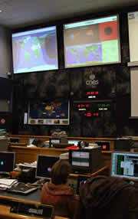
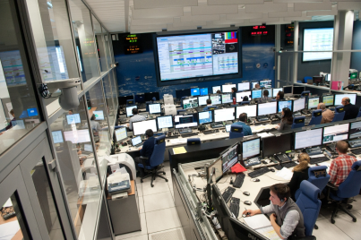
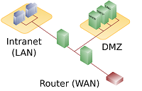


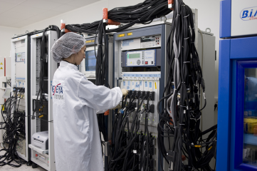

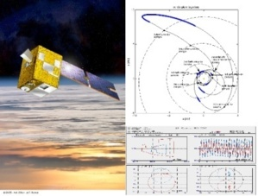
Automation Operation Concept For Next CNES Missions
ISIS Product Line is designed to cover :
Control Command Center
Main Control Room
DMZ
Expert Computer
Multi Targets
Assembly, Integration, and Test
On Call Computer
Fly Dynamics Standalone

Slide 9
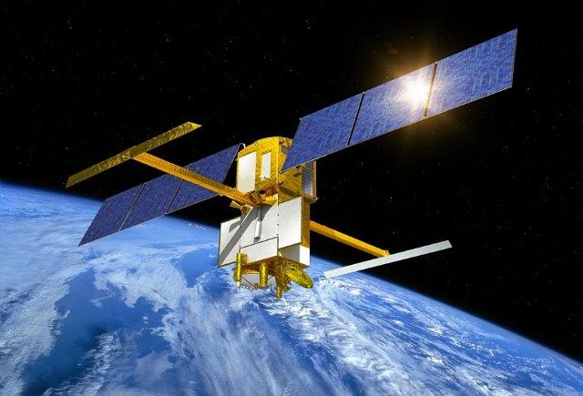
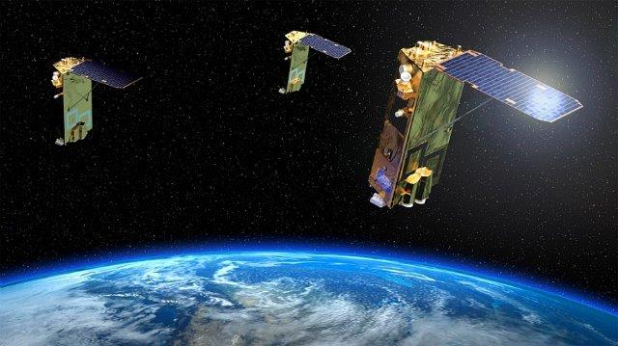
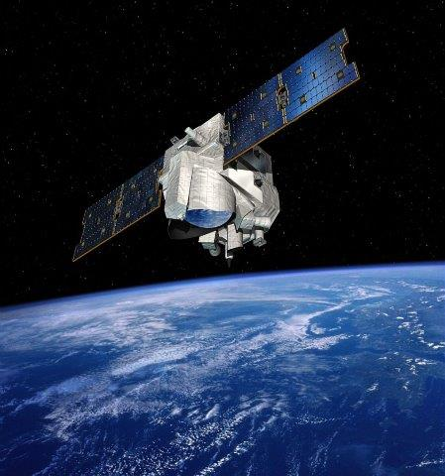
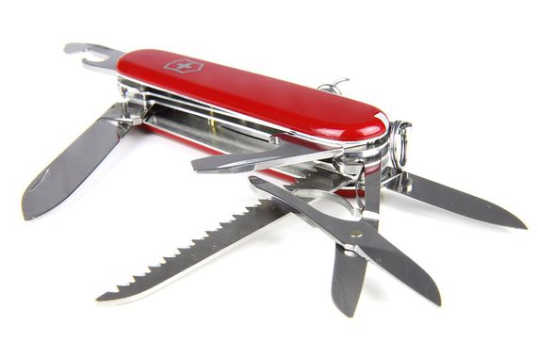
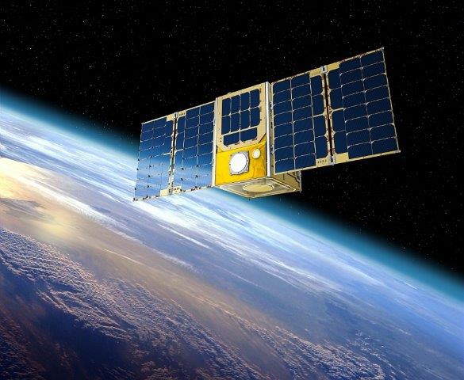
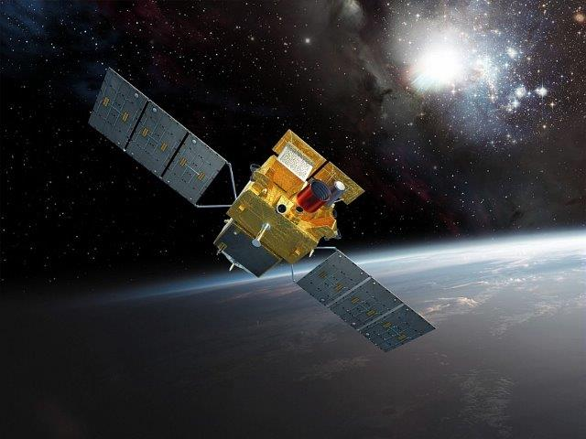
Automation Operation Concept For Next CNES Missions
ISIS Product Line is designed to cover :
SWOT
MERLIN
CERES
Argos 4 NG
Multi Missions
…
NeSS
SVOM
One mission target is a product line implementation built on :
  A selection of common and mission specific components delivered by the IT company or CNES teams
  And a deployment of these components on a set of Virtual Machines
A topology

Slide 10
Example of the SWOT CCC target implementation cycle of life
Automation Operation Concept For Next CNES Missions
SWOT
Spectre
SWOT
Merlin
CERES
CERES
SVOM
CERES
Dépendencies
SWOT + Spectre
SWOT + Merlin
CNES Generic Missions
(AIT, Scientific, Military,…)
ISIS Product Line
= RPMs, scripts, configurations
SWOT assembly
SWOT CCC target
10

Slide 11


Management of this multi-mission/target process
Automation Operation Concept For Next CNES Missions
To manage all the piece of software, scripts, configuration files …
- hosts : WebServer
tasks:
- name : Start HTTP server
service:
name: "{{ httpd_service_name }}"
state: started
- hosts : Database
roles:
- role: InstallMariaDB
To manage the configuration and to deploy automatically a mission target
version_configuration:
operational:
mission_system_version: "1.0"
fds_system_version: "3.1.6"
ccc_system_version: "8.14.2b"
....
validation01:
mission_system_version: "2.0"
fds_system_version: "3.1.7"
ccc_system_version: "8.15"

Slide 12
During operationnal phase
ISIS Operational Concept

Slide 13
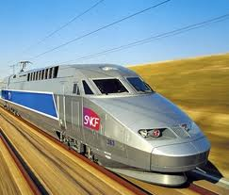


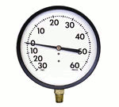
Operationnal concept driver before software development
Automation Operation Concept For Next CNES Missions
  Automated but :
Plan the itinerary
Check of the right behavior
And possible manual interruption
Sequence of operations to perform
Supervision of on-going operations
Switch to manual by the operators
Automation : operations scheduling by rules or on the fly, full control centre automation

Slide 14

BUS
Automation Operation Concept For Next CNES Missions
All operations (complex or simple) can be automated
  Either ground/board or ground operation
  From high level function (eg. connect TM flow procedure) to low level operation using all the API exposed by all the components (eg. getParameterValue(CPU_load) )
  Example:
Connection
Acquisition
Decom’
Frames
Decommuted parameters
DataStore
Packets

Slide 15
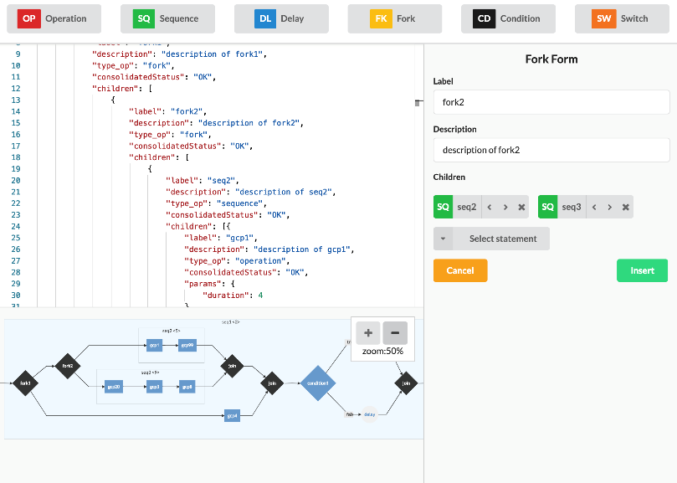
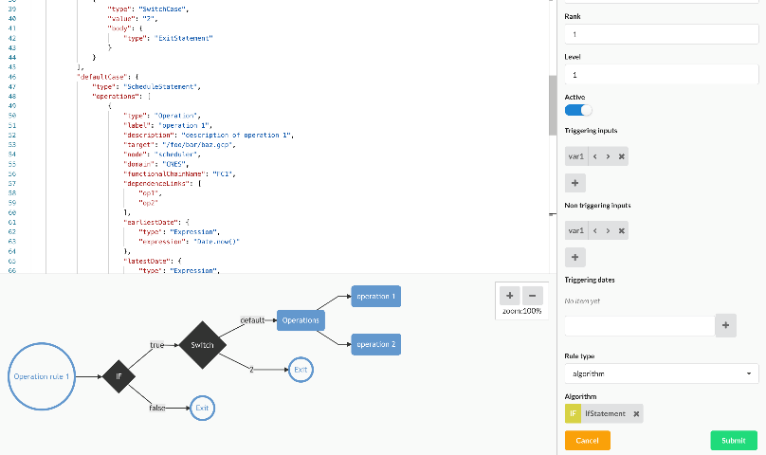
Rule based scheduling
Automation Operation Concept For Next CNES Missions
  Offline schedule based on expected events (eclipse, station change, maintenance) , dates, internal variables …
  Real time conditional execution (based on CCC or satellite parameters)
  Real time reaction to events based on reflexes rules (onboard alarm, safe-mode, critical failure,…)

Slide 16
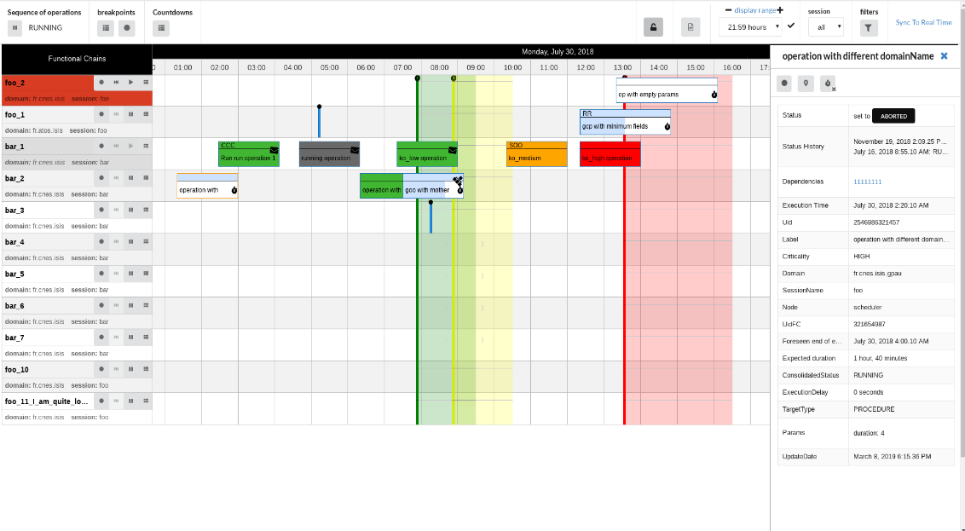
Operations orchestration and supervision : level 1
Automation Operation Concept For Next CNES Missions
System view of the operations
with high level control if needed

Slide 17
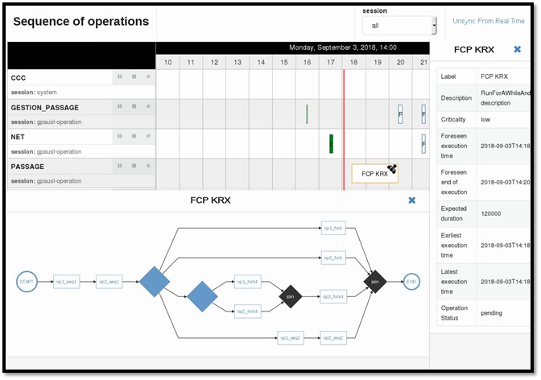
Automation Operation Concept For Next CNES Missions
Operations orchestration and supervision : level 2
Group of operations zoom view

Slide 18
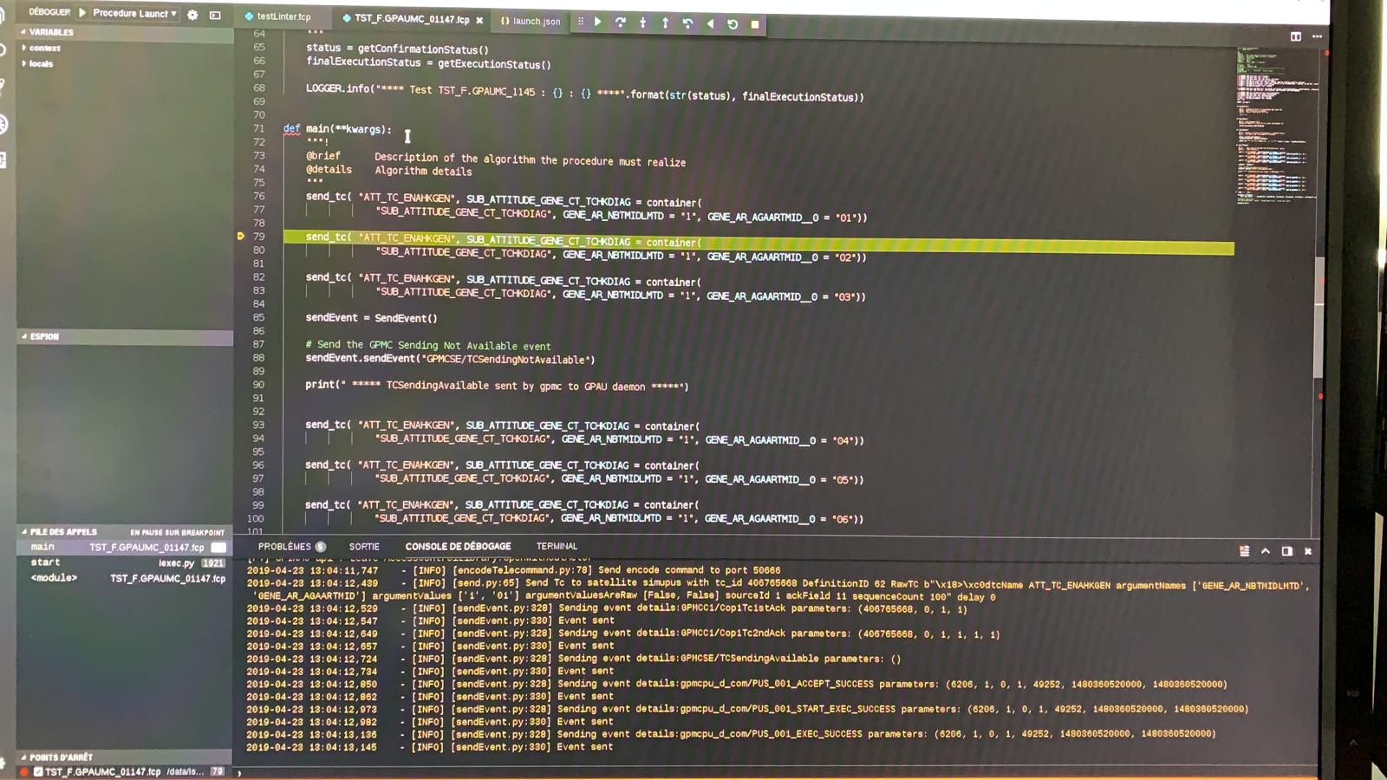
Automation Operation Concept For Next CNES Missions
Operations orchestration and supervision : level 3
Detail view of an operation
with step by step control if needed

Slide 19
Operations orchestration and supervision : scalability
Automation Operation Concept For Next CNES Missions
Fully configurable
  Within the 3 levels : system, group of operations and operations
  Able to cope with any mission choices
Very simple to add new operations
  Mostly written in Python,
  Can be any executable
Possibility to schedule a new operation at any time
  Depending on pattern matching on logbook events
  Logbook events sent by any component of the product line

Slide 20
Conclusion
ISIS Operational Concept

Slide 21
ISIS Product Line : first feedback
Automation Operation Concept For Next CNES Missions
A real upgradeable and scalable micro architecture
  Easy to add new functionality (e.g. 4 and 5 specific components added for the first missions, to compare to ~100 common components)
  Choose the distribution of the components depending on the deployment and hardware characteristic (Control Command Center, Main Control Room, AIT Testbed ..)
  Possibility to adapt hardware to specific target performances
Improvement of the automation subsystem, scalable within the 3 levels and able to react in real time
Ready for various multi missions : typical ones (1 and 3 satellites), constellation, AIT …
But new operational way of thinking to compare to “old CCC” : from MMI control to deamon execution with MMI for supervision

